Slide 1


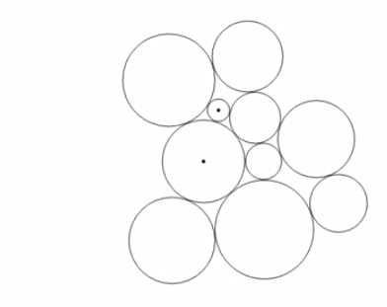
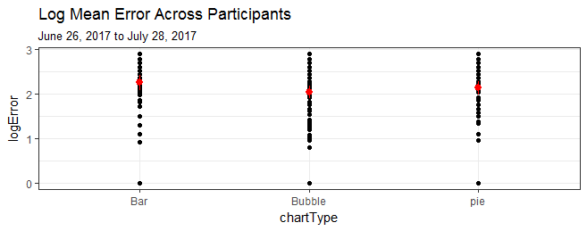
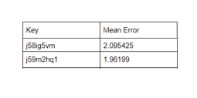
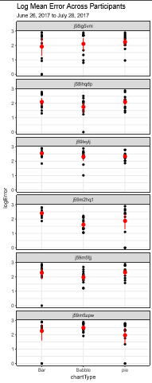
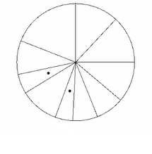
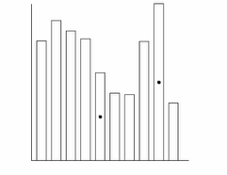
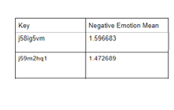
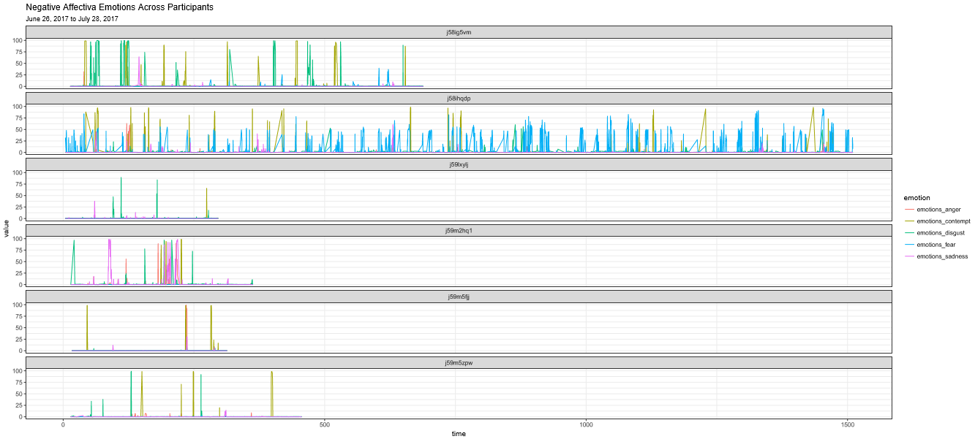
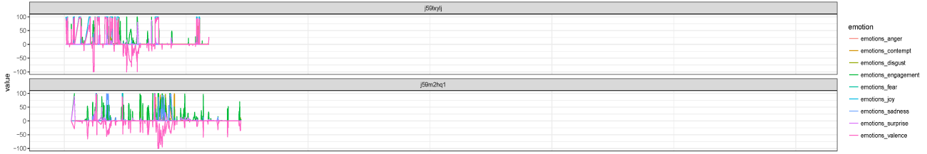
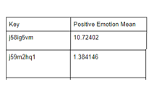
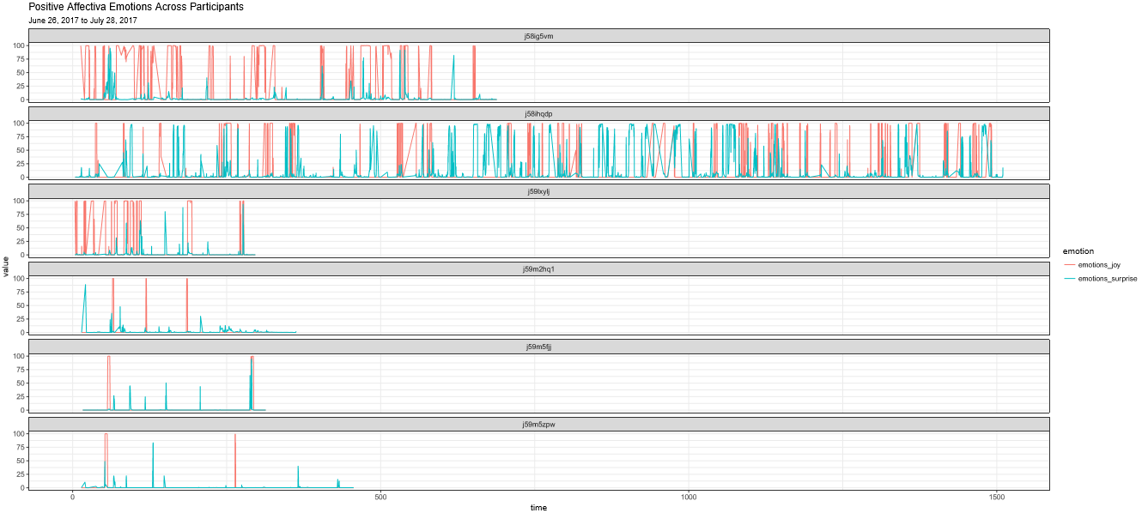

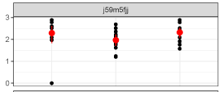
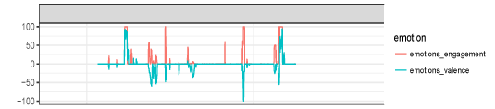
Data Visualization and Emotion Detection
Students: Joyce Fang, Ohemaa Prempeh
Advisor: Professor Lane Harrison
Program in Bioinformatics
and Computational Biology
Summer Research Experience
for High School Students
Abstract
Chart Accuracy Test
Participants Experiencing Less Intense Negative and Positive Emotions Were More Accurate
Studying facial expressions along with accuracy when analyzing data visualizations can help us predict and understand how well people read data in different types of situations. By using Affectiva, an emotion-sensing software, and a simple chart test, we are able to find connections between emotions and accuracy when reading data visualizations, which could help find better ways to express information to people in stressful situations.
The participant inputs, for each type of chart, what he/she thinks is the percentage of the smaller part over the larger part.
The participant answers questions regarding how he/she felt while taking the test in a survey to provide information about how accurate Affectiva is.
Participants who experienced frequent and intense negative and positive emotions were less accurate than those who had more stable and fewer emotions.
Background
Data visualization is a term used to describe the use of visual effects to present data in an efficient way.
Affectiva is a software that has a data base of thousands of faces from around the world; it maps out a person’s face and analyzes facial movements to determine the emotions he/she is feeling.
In hospitals and doctors’ offices, patients are responsible for analyzing medical data and making decisions based off of it, but stress is a factor that may prevent a patient from making informed decisions.
Fig 2. An example of the three types of chart problems on the test.
Fig 3. An error chart organized by chart type (bar, bubble, and pie) with the mean error for each type shown (red dots).
Using Affectiva to Produce Emotion Data
Run Affectiva through the webcam of a computer while the participant is doing the chart accuracy test.
Fig 4. An emotion chart Affectiva produces, with colored lines corresponding to anger, contempt, disgust, engagement, dear, joy, sadness, surprise, and valence.
Fig 6. A comparison between error, negative emotions (fear, anger, disgust, contempt, and sadness), and positive emotions (joy and surprise) for two participants.
Participant with Stable Negative Valence and Engagement Performed the Best
Fig 1. Medical decisions often require patients to interpret data, but stress is a factor that often influences their decisions.
The participant with the least error had negative valence and emotional stability throughout the experiment. Valence is the overall negative or positive state a person is in.
Conclusion
People with high levels of negative or positive emotions tended to be less accurate than those who had stable and fewer emotions.
Results suggest that emotional stability also leads to increased accuracy when reading data visualizations.
Objectives
To analyze how peoples’ emotions change while observing data visualizations.
To find connections between emotions and accuracy when reading data visualizations.
To be able to predict how well people read data in stressful situations.
Future Work
Test more participants of different ages, genders, etc. to get more variation in test subjects.
Do more analysis/make charts for different parts of the data to see if there are any other correlations between the two data sets.
Fig 5. The error chart next to the emotion chart depicting engagement (red) and valence (blue).

